Slide 1
STORAGE OF HYDROGEN

Slide 2
HYDROGEN STORAGE CHALLENGES
For transportation, the overarching technical challenge for hydrogen storage is how to store the amount of hydrogen required for a conventional driving range (>300 miles) within the vehicular constraints of weight, volume, efficiency, safety, and cost. Durability over the performance lifetime of these systems must also be verified and validated, and acceptable refueling times must be achieved. Requirements for off-board bulk storage are generally less restrictive than on-board requirements; for example, there may be no or less-restrictive weight requirements, but there may be volume or "footprint" requirements. The key challenges include :
Weight and Volume : The weight and volume of hydrogen storage systems are presently too high, resulting in inadequate vehicle range compared to conventional petroleum fueled vehicles. Materials and components are needed that allow compact, lightweight, hydrogen storage systems while enabling mile range greater than 300 miles in all light-duty vehicle platforms.
Efficiency : Energy efficiency is a challenge for all hydrogen storage approaches. The energy required to get hydrogen in and out Is an issue for reversible solid-state materials. Life-cycle energy efficiency is a challenge for chemical hydride storage in which the byproduct is regenerated off-board. In addition, the energy associated with compression and liquefaction must be considered for compressed and liquid hydrogen technologies.
Durability : Durability of hydrogen storage systems is inadequate. Materials and components are needed that allow hydrogen storage systems with a lifetime of 1500 cycles.
Refueling Time : Refueling times are too long. There is a need to develop hydrogen storage systems with refueling times of less
than three minutes over the lifetime of the system.
Cost : The cost of on-board hydrogen storage systems is too high, particularly in comparison with conventional storage systems for petroleum fuels. Low-cost materials and components for hydrogen storage systems are needed, as well as low-cost, high-volume manufacturing methods.
Codes and Standards : Applicable codes and standards for hydrogen storage systems and interface technologies, which will facilitate implementation/commercialization and ensure safety and public acceptance, have not been established. Standardized hardware and operating procedures, and applicable codes and standards, are required.
Life-Cycle and Efficiency Analyses : There is a lack of analyses of the full life-cycle cost and efficiency for hydrogen storage systems.

Slide 3
Comparison of major viable technologies for storing hydrogen fuel
Hydrogen storage technology | Advantages | Disadvantages
Cryogenic liquid hydrogen (LH₂ ) | High storage density at low pressure. | Large evaporative loss. A need of substantial amount of electricity for liquefaction.
Compressed gaseous hydrogen (GH₂) | Viable technology for hydrogen storage due to the great improvements in high strength composite fibers. | Temperature increases as GH₂ is pumped into a storage vessel, which reduces the density of storage. Safety of high pressure tanks.
Chemical hydrides and metal hydrides | A safe medium to deliver hydrogen at a constant pressure. | Very heavy and thus reduce a vehicle’s driving range. It requires substantial amount of energy to absorb and release the stored hydrogen.
Carbon-based hydrogen storage | Carbon nanotubes with high surface area show some promise for hydrogen storage. | Carbon nanotubes and their hydrogen storage capacity are still in the research and development stage.

Slide 4
Under pressure
Hydrogen is an ultra-light gas that can be highly compressed to reduce its specific volume.
The easiest way to decrease the volume of a gas, at constant temperatures, is to increase its pressure.
So, at 700 bar, which is 700 times normal atmospheric pressure, hydrogen has a density of 42 kg/m³, compared with 0.090 kg/m³ under normal pressure and temperature conditions. At this pressure, 5 kg of hydrogen can be stored in a 125-liter tank.
Today, hydrogen is already being distributed in steel cylinders in which it is stored at 200 bar.
To further improve storage capacity, manufacturers are developing composite cylinders or tanks made of much lighter weight materials than steel, and which allow us to store hydrogen at a pressure of 700 bar.
Today, most car manufacturers have opted for the solution that consists in storing hydrogen in the gaseous form, at high pressure. This technology enables us to store enough hydrogen to allow a car that runs on a fuel cell battery to cover between 500 and 600 km between fill-ups.

Slide 5
Efficient storage
To ensure easier and more efficient transport, hydrogen is stored in tanks or cylinders made of composite materials.
Air Liquide researchers are participating actively in the development of composite cylinders used for stationary applications, especially at isolated sites.
In particular, researchers are focusing on the mechanical strength over time of the materials that compose these cylinders. They conduct accelerated stress tests using filling cycles. They also conduct numerous tests for permeability at very high pressure to ensure that cylinders and tanks are perfectly impermeable.
All of this research will determine the scientific foundations of the performance and evolution of materials, and enable to determine the sizing criteria for tanks. Thanks to this research, Air Liquide has become a key player in the quest to define the safety standards that will be implemented to ensure maximal safety for the user. This is one of the objectives of the European HyComp project, which Air Liquide is coordinating. The aim of the project is to establish the bases as well as the technical data related to the performance of composite cylinders, so that its durability (useful life) can be justified and its safety coefficient optimized.
Another avenue of research is the development of technologies for conducting controls on the cylinders during their use. This step is also vital for ensuring user safety. It entails making sure that there are no hidden defects such as micro cracks. Researchers are mastering methods of non-destructive controls, for example acoustic emission, that enable these kinds of anomalies to be detected.

Slide 6
In the liquid form
A cutting-edge technique for storing a maximum of hydrogen in a restricted volume consists of transforming gaseous hydrogen into liquid hydrogen by cooling it down to a very low temperature.
Hydrogen turns into a liquid when it is cooled to a temperature below -250 °C.
At -252.8°C and 1.013 Bar, liquid hydrogen has a density of close to 71 kg/m³. At this pressure, 5 kg of hydrogen can be stored in a 75-liter tank.
In order to maintain liquid hydrogen at this temperature, tanks must be perfectly isolated.
Storing hydrogen in the liquid form is an option for just a limited number of applications so far, in high-tech areas such as space travel.
For example, the tanks on the Ariane launcher, designed and manufactured by Air Liquide, contain the 28 tons of liquid hydrogen that will provide fuel to the central engine. These tanks are a genuine example of technological prowess: they weigh only 5.5 tons empty and their casing is not more than 1.3 mm thick.

Slide 7
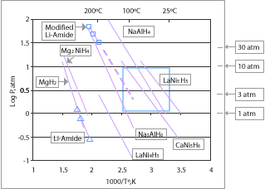
In the solid form
Storing solid hydrogen, i.e. conserving it inside another material, is also a promising avenue for research.
The methods used to store hydrogen in the solid form involve techniques that bring into play the mechanisms of absorption or adsorption of hydrogen by a material.
One example is to form solid metallic hydrides through the reaction of hydrogen with certain metal alloys. This absorption is the result of the reversible chemical combination of hydrogen with the atoms that comprise these materials. The most promising materials are composed of magnesium and alanates.
Only a low mass of hydrogen can be stored in these materials, which is currently the major downside of this technology. In fact, the best materials currently generate a ratio of hydrogen weight to the total weight of the tank of not more than 2 to 3%.
Before considering large-scale applications, it is also important to master certain key parameters such as kinetics (cell performance), and the temperature and pressure of the charge and discharge cycles of hydrogen in these materials.

Slide 8
Metal hydrides, such as MgH₂, NaAlH₄, LiAlH₄, LiH, LaNi₅H₆, TiFeH₂ and palladium hydride, with varying degrees of efficiency, can be used as a storage medium for hydrogen, often reversibly. Some are easy-to-fuel liquids at ambient temperature and pressure, others are solids which could be turned into pellets. These materials have good energy density by volume, although their energy density by weight is often worse than the leading hydrocarbon fuels.
Most metal hydrides bind with hydrogen very strongly. As a result high temperatures around 120 °C (248 °F) – 200 °C (392 °F) are required to release their hydrogen content. This energy cost can be reduced by using alloys which consists of a strong hydride former and a weak one such as in LiNH₂, LiBH₄ and NaBH₄. These are able to form weaker bonds, thereby requiring less input to release stored hydrogen. However if the interaction is too weak, the pressure needed for rehydriding is high, thereby eliminating any energy savings. The target for onboard hydrogen fuel systems is roughly <100 °C for release and <700 bar for recharge (20–60 kJ/mol H₂).
An alternative method for reducing dissociation temperatures is doping with activators. This has been successfully used for aluminium hydride but its complex synthesis makes it undesirable for most applications as it is not easily recharged with hydrogen.
Currently the only hydrides which are capable of achieving the 9 wt.% gravimetric goal for 2015 are limited to lithium, boron and aluminium based compounds; at least one of the first-row elements or Al must be added. Research is being done to determine new compounds which can be used to meet these requirements.
Proposed hydrides for use in a hydrogen economy include simple hydrides of magnesium or transition metals and complex metal hydrides, typically containing sodium, lithium, or calcium and aluminium or boron. Hydrides chosen for storage applications provide low reactivity (high safety) and high hydrogen storage densities. Leading candidates are lithium hydride, sodium borohydride, lithium aluminium hydride and ammonia borane.
A French company McPhy Energy is developing the first industrial product, based on magnesium hydride, already sold to some major clients such as Iwatani and ENEL.
New Scientist stated that Arizona State University is investigating using a borohydride solution to store hydrogen, which is released when the solution flows over a catalyst made of ruthenium.
Researchers at University of Pittsburgh and Georgia Tech performed extensive benchmarking simulations on mixtures of several light metal hydrides to predict possible reaction thermodynamics for hydrogen storage.

Slide 9
Carbohydrates
Carbohydrates (polymeric C₆H₁₀O₅) releases H₂ in a bioreformer mediated by the enzyme cocktail—cell-free synthetic pathway biotransformation. Carbohydrate provides high hydrogen storage densities as a liquid with mild pressurization and cryogenic constraints. It can also be stored as a solid powder. Carbohydrate is the most abundant renewable bioresource in the world.
In May 2007, biochemical engineers from the Virginia Polytechnic Institute and State University and biologists and chemists from the Oak Ridge National Laboratory announced a method of producing high-yield pure hydrogen from starch and water. In 2009, they demonstrated to produce nearly 12 moles of hydrogen per glucose unit from cellulosic materials and water. Thanks to complete conversion and modest reaction conditions, they propose to use carbohydrate as a high energy density hydrogen carrier with a density of 14.8 wt%.
Synthesized hydrocarbons
An alternative to hydrides is to use regular hydrocarbon fuels as the hydrogen carrier. Then a small hydrogen reformer would extract the hydrogen as needed by the fuel cell. However, these reformers are slow to react to changes in demand and add a large incremental cost.
Direct methanol fuel cells do not require a reformer, but provide a lower energy density compared to conventional fuel cells, although this could be counterbalanced with the much better energy densities of ethanol and methanol over hydrogen. Alcohol fuel is a renewable resource.
Solid-oxide fuel cells can operate on light hydrocarbons such as propane and methane without a reformer, or can run on higher hydrocarbons with only partial reforming, but the high temperature and slow startup time of these fuel cells are problematic for automotive applications.
Liquid organic hydrogen carriers (LOHC)
Unsaturated organic compounds can store huge amounts of hydrogen. These Liquid Organic Hydrogen Carriers (LOHC) are hydrogenated for storage and dehydrogenated again when the energy/hydrogen is needed. Heterocyclic aromatic compounds are most appropriate for this task. A compound that stands in the focus of the current LOHC research is N-ethylcarbazole but many others do exist, e.g. dibenzyltoluene which is already industrially used as a heat transfer fluid.
Using LOHCs relatively high gravimetric storage densities can be reached (about 6 wt.%) and the overall energy efficiency is higher than for other chemical storage options such as producing methane from the hydrogen.

Slide 10
Ammonia
Ammonia (NH₃) releases H₂ in an appropriate catalytic reformer. Ammonia provides high hydrogen storage densities as a liquid with mild pressurization and cryogenic constraints. It can also be stored as a liquid at room temperature and pressure when mixed with water. Ammonia is the second most commonly produced chemical in the world and a large infrastructure for making, transporting, and distributing ammonia exists. Ammonia can be reformed to produce hydrogen with no harmful waste, or can mix with existing fuels and under the right conditions burn efficiently. Pure ammonia burns poorly at the atmospheric pressures found in natural gas fired water heaters and stoves. Under compression in an automobile engine it is a suitable fuel for slightly modified gasoline engines. Ammonia is a toxic gas at normal temperature and pressure and has a potent odor.
In September 2005 chemists from the Technical University of Denmark announced a method of storing hydrogen in the form of ammonia saturated into a salt tablet. They claim it will be an inexpensive and safe storage method.
Amine borane complexes
Prior to 1980, several compounds were investigated for hydrogen storage including complex borohydrides, or aluminohydrides, and ammonium salts. These hydrides have an upper theoretical hydrogen yield limited to about 8.5% by weight. Representative examples include: amine boranes, boron hydride ammoniates, hydrazine-borane complexes, and ammonium octahydrotriborates or tetrahydroborates. Of these, amine boranes (and especially ammonia borane) have been extensively investigated as hydrogen carriers. During the 1970s and 1980s, the U.S. Army and Navy funded efforts aimed at developing hydrogen/deuterium gas-generating compounds for use in the HF/DF and HCl chemical lasers, and gas dynamic lasers. Earlier hydrogen gas-generating formulations used amine boranes and their derivatives. Ignition of the amine borane (s) forms boron nitride (BN) and hydrogen gas. In addition to ammonia borane (H₃BNH₃), other gas-generators include diborane diammoniate, H₂B(NH₃)₂BH₄.
Formic acid
In 2006, researchers of EPFL, Switzerland, reported the use of formic acid as a hydrogen storage material. Carbon monoxide free hydrogen has been generated in a very wide pressure range (1–600 bar). A homogeneous catalytic system based on water soluble ruthenium catalysts selectively decompose HCOOH into H₂ and CO₂ in aqueous solution. This catalytic system overcomes the limitations of other catalysts (e.g. poor stability, limited catalytic lifetimes, formation of CO) for the decomposition of formic acid making it a viable hydrogen storage material. And the co-product of this decomposition, carbon dioxide, can be used as hydrogen vector by hydrogenating it back to formic acid in a second step. The catalytic hydrogenation of CO₂ has long been studied and efficient procedures have been developed. Formic acid contains 53 g L⁻¹ hydrogen at room temperature and atmospheric pressure. By weight, pure formic acid stores 4.3 wt% hydrogen. Pure formic acid is a liquid with a flash point 69 °C (cf. gasoline −40 °C, ethanol 13 °C). 85% formic acid is not flammable.

Slide 11
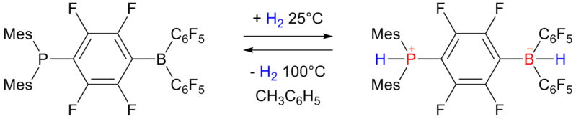
Phosphonium borate
In 2006 researchers of University of Windsor reported on reversible hydrogen storage in a non-metal phosphonium borate frustrated Lewis pair
The phosphino-borane on the left accepts one equivalent of hydrogen at one atmosphere and 25 °C and expels it again by heating to 100 °C. The storage capacity is 0.25 wt% still rather below the 6 to 9 wt% required for practical use.
Carbonite substances
Research has proven that graphene can store hydrogen efficiently. After taking up hydrogen, the substance becomes graphane. After tests, conducted by André Geim at the University of Manchester, it was shown that not only graphene can store hydrogen easily, it can also release the hydrogen again, after heating to 450 °C.
Cryo-compressed
Cryo-compressed storage of hydrogen is the only technology that meets 2015 DOE targets for volumetric and gravimetric efficiency.
Furthermore, another study has shown that cryo-compressed exhibits interesting cost advantages: ownership cost (price per mile) and storage system cost (price per vehicle) are actually the lowest when compared to any other technology. For example, a cryo-compressed hydrogen system would cost $0.12 per mile (including cost of fuel and every associated other cost), while conventional gasoline vehicles cost between $0.05 and $0.07 per mile.
Like liquid storage, cryo-compressed uses cold hydrogen (20.3 K and slightly above) in order to reach a high energy density. However, the main difference is that, when the hydrogen would warm-up due to heat transfer with the environment ("boil off"), the tank is allowed to go to pressures much higher (up to 350 bars versus a couple of bars for liquid storage). As a consequence, it takes more time before the hydrogen has to vent, and in most driving situations, enough hydrogen is used by the car to keep the pressure well below the venting limit.
Consequently, it has been demonstrated that a high driving range could be achieved with a cryo-compressed tank : more than 650 miles (1,050 km) were driven with a full tank mounted on an hydrogen-fueled engine of Toyota Prius. Research is still on its way in order to study and demonstrate the full potential of the technology.
As of 2010, the BMW Group has started a thorough component and system level validation of cryo-compressed vehicle storage on its way to a commercial product.

Slide 12
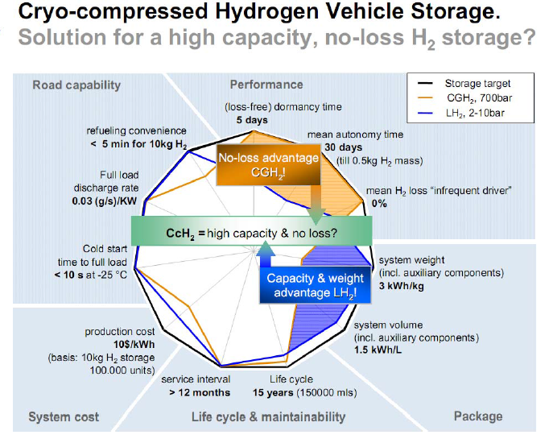
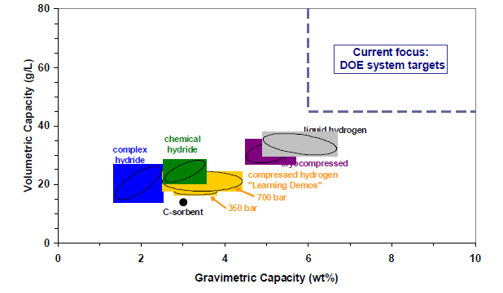

Slide 13
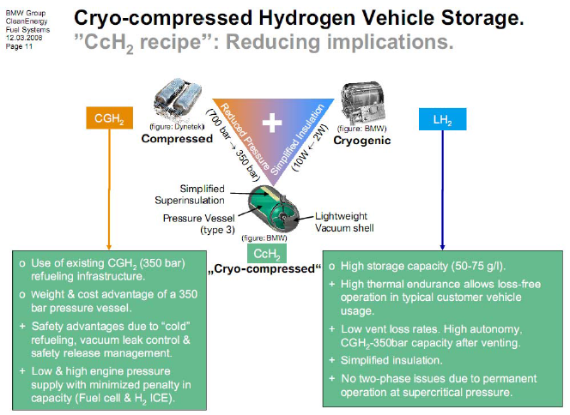

Slide 14
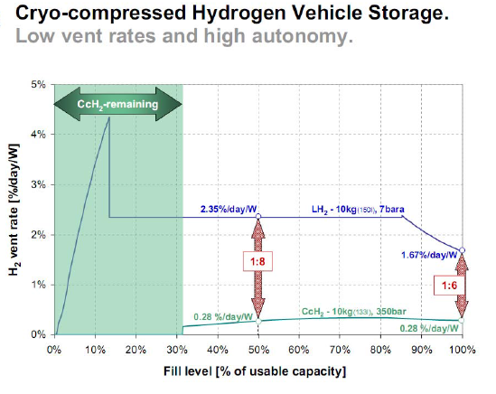
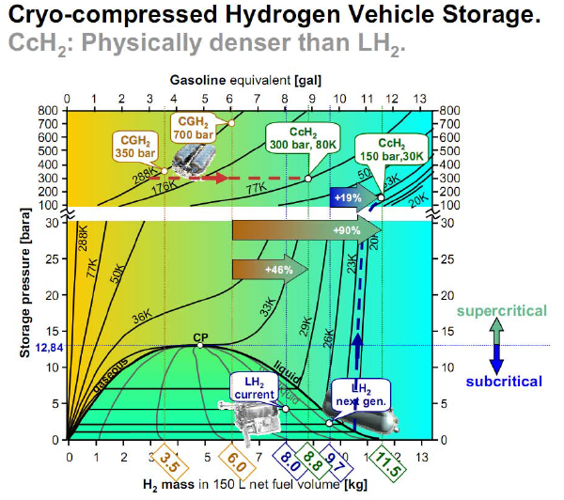

Slide 15
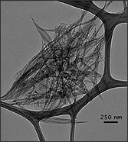
Imidazolium ionic liquids
In 2007, Dupont and others reported hydrogen-storage materials based on imidazolium ionic liquids. Simple alkyl(aryl)-3-methylimidazolium N-bis (trifluoromethanesulfonyl) imidate salts that possess very low vapor pressure, high density, and thermal stability and are not inflammable can add reversibly 6–12 hydrogen atoms in the presence of classical Pd/C or Ir⁰ nanoparticle catalysts and can be used as alternative materials for on-board hydrogen-storage devices. These salts can hold up to 30 g L⁻¹ of hydrogen at atmospheric pressure.
Carbon nanotubes
Hydrogen carriers based on nanostructured carbon (such as carbon buckyballs and nanotubes) have been proposed. However, since Hydrogen usually amounts up to ~3.0-7.0 wt.% at 77K which is far from the value set by US department of Energy (6wt.% at nearly ambient conditions), it makes carbon materials poor candidates for hydrogen storage.
Metal-organic frameworks (MOF)
Metal-organic frameworks represent another class of synthetic porous materials that store hydrogen and energy at the molecular level. MOFs are highly crystalline inorganic-organic hybrid structures that contain metal clusters or ions (secondary building units) as nodes and organic ligands as linkers. When guest molecules (solvent) occupying the pores are removed during solvent exchange and heating under vacuum, porous structure of MOFs can be achieved without destabilizing the frame and hydrogen molecules will be adsorbed onto the surface of the pores by physisorption. Compared to traditional zeolites and porous carbon materials, MOFs have very high number of pores and surface area which allow higher hydrogen uptake in a given volume. Thus, research interests on hydrogen storage in MOFs have been growing since 2003 when the first MOF-based hydrogen storage was introduced. Since there are infinite geometric and chemical variations of MOFs based on different combinations of SBUs and linkers, many researches explore what combination will provide the maximum hydrogen uptake by varying materials of metal ions and linkers.
In 2006, chemists at UCLA and the University of Michigan have achieved hydrogen storage concentrations of up to 7.5 wt% in MOF-74 at a low temperature of 77 K. In 2009, researchers at University of Nottingham reached 10 wt% at 77 bar (1,117 psi) and 77 K with MOF NOTT-112. Most articles about hydrogen storage in MOFs report hydrogen uptake capacity at a temperature of 77 K and a pressure of 1 bar because such condition is commonly available and the binding energy between hydrogen and MOF is large compare to the thermal vibration energy which will allow high hydrogen uptake capacity. Varying several factors such as surface area, pore size, catenation, ligand structure, spillover, and sample purity can result different amount of hydrogen uptake in MOFs.

Slide 16
Clathrate hydrates
H₂ caged in a clathrate hydrate was first reported in 2002, but requires very high pressures to be stable. In 2004, researchers from Delft University of Technology and Colorado School of Mines showed solid H₂-containing hydrates could be formed at ambient temperature and 10s of bar by adding small amounts of promoting substances such as THF. These clathrates have a theoretical maximum hydrogen densities of around 5 wt% and 40 kg/m³.
Encapsulation
Cella Energy technology is based around the encapsulation and nano-structuring of chemical hydrides in plastic.
Glass capillary arrays
A team of Russian, Israeli and German scientists have collaboratively developed an innovative technology based on glass capillary arrays for the safe infusion, storage and controlled release of hydrogen in mobile applications. The C. En technology has achieved the United States DOE 2010 targets for on-board hydrogen storage systems. DOE 2015 targets can be achieved using flexible glass capillaries and cryo-compressed method of hydrogen storage.
Glass microspheres
Hollow glass microspheres (HGM) can be utilized for controlled storage and release of hydrogen.

Slide 17
Stationary hydrogen storage
Unlike mobile applications, hydrogen density is not a huge problem for stationary applications. As for mobile applications, stationary applications can use established technology :
Compressed hydrogen (GH₂) in a hydrogen tank
Liquid hydrogen in a (LH₂) cryogenic hydrogen tank
Slush hydrogen in a cryogenic hydrogen tank
Underground hydrogen storage
Underground hydrogen storage is the practice of hydrogen storage in underground caverns, salt domes and depleted oil and gas fields. Large quantities of gaseous hydrogen have been stored in underground caverns by ICI for many years without any difficulties. The storage of large quantities of liquid hydrogen underground can function as grid energy storage. The round-trip efficiency is approximately 40% (vs. 78% for pumped-hydro), and the cost is slightly higher than pumped hydro.
Power to gas
Power to gas is a technology which converts electrical power to a gas fuel. There are 2 methods, the first is to use the electricity for water splitting and inject the resulting hydrogen into the natural gas grid. The second less efficient method is used to convert carbon dioxide and water to methane, using electrolysis and the Sabatier reaction. The excess power or off peak power generated by wind generators or solar arrays is then used for load balancing in the energy grid. Using the existing natural gas system for hydrogen Fuel cell maker Hydrogenics and natural gas distributor Enbridge have teamed up to develop such a power to gas system in Canada.
Pipeline storage of hydrogen where a natural gas network is used for the storage of hydrogen. Before switching to natural gas, the German gas networks were operated using towngas, which for the most part (60-65%) consisted of hydrogen. The storage capacity of the German natural gas network is more than 200,000 GW·h which is enough for several months of energy requirement. By comparison, the capacity of all German pumped storage power plants amounts to only about 40 GW·h. The transport of energy through a gas network is done with much less loss (<0.1%) than in a power network (8%). The use of the existing natural gas pipelines for hydrogen was studied by NaturalHy.

